Slide 1



PROGRAMMING FUNDAMENTALS IN C
Problem Solving in C

Slide 2
Motivation
Write a C program to output “Welcome To C course, <YOUR NAME>”
Use CMD and notepad ONLY.
#include <stdio.h>
int main()
{
printf("%s\n","Welcome to C course, Omar");
return 0;
}

Slide 3
Motivation
Write a C program to output “Welcome To C course, <YOUR NAME>”
Save the file as “welcome.c”
Open cmd in the folder contains code
Write “gcc welcome.c”
Run the output exe file, “a.exe”
#include <stdio.h>
int main()
{
printf("%s\n","Welcome to C course, Omar");
return 0;
}

Slide 4

Motivation
Write a C program to output “Welcome To C course, <YOUR NAME>”
Save the file as “welcome.c”
Open cmd in the folder contains code
Write “gcc welcome.c”
Run the output exe file, “a.exe”
#include <stdio.h>
int main()
{
printf("%s\n","Welcome to C course, Omar");
return 0;
}
You can use visual studio compiler from cmd
Open developer command prompt
Compile the file using $cl <FILENAME.c>$
Run the file using <FILENAME.exe> https://docs.microsoft.com/en-us/cpp/build/walkthrough-compile-a-c-program-on-the-command-line?redirectedfrom=MSDN&view=msvc-160

Slide 5
Objectives
Write Simple C programs
Comments
Use simple I/O
Understanding basic data types in C
Use arithmetic operators
Understand the precedence of C operators
Using selections statements

Slide 6
Introduction to C Programming
The structure of a basic C program
Data types and keywords
Mathematical Operations in C
I/O in C
Exercises: Pseudocode, Flow chart, Code
Conditions

Slide 7

The structure of a basic C program
$\#include<stdio.h>$
$\#include$: this called preprocessor directive
$stdio.h$: is a header file contains $printf()$ function and other IO functions
Get the file called $stdio.h$ to use the functions inside it
#include <stdio.h>
int main()
{
printf("%s\n","Welcome to C course, Omar");
return 0;
}

Slide 8

The structure of a basic C program
$int main()$
$int$: a data type identifies the function will return an INTEGER value
$main$: function name, it’s the entry point to every C program
$()$: parenthesis to pass parameters to a function
$\{$: curly brackets indicates the start of function body
#include <stdio.h>
int main()
{
printf("%s\n","Welcome to C course, Omar");
return 0;
}

Slide 9

The structure of a basic C program
$printf\left("\text{\%}\text{s}\text{\backslash }\text{n}\text{"},\text{"}\text{Welcome} \text{to} \text{C} \text{course}\text{, }\text{Omar}\text{"}\right);$
$printf()$: a function the prints the data between () to the console screen
$"\%s\backslash n“$: control parameter, indicates the function prints a string
A string is a sequence of characters, symbols and digits
%s = refers to string
\n = print new line
Any string after “,” is printed as it is
The $;$ indicates the end of a statement
#include <stdio.h>
int main()
{
printf("%s\n","Welcome to C course, Omar");
return 0;
}

Slide 10

The structure of a basic C program
$return 0;$
$return$: is a keyword indicates that a function will return a value – 0
$\}$: is the end of the function body
#include <stdio.h>
int main()
{
printf("%s\n","Welcome to C course, Omar");
return 0;
}

Slide 11

The structure of a basic C program
Notes about the code:
Almost every statement in C is terminated by ;
The control parameter $"\%s\backslash n“$ is not displayed on a screen.
Any thing between “ “ is printed as it is
The $return$ keyword is the last statement executed in the function block
You can write multiple statements in one line separated by a ;
#include <stdio.h>
int main()
{
printf("%s\n","Welcome to C course, Omar");
return 0;
}

Slide 12
Detect the variations
Different code, same result
#include <stdio.h>
int main()
{
printf("%s\n","Welcome to C course, Omar");
return 0;
}
#include <stdio.h>
int main( void )
{
printf( "Welcome to C course, Omar\n" );
}
#include <stdio.h>
void main()
{
printf( "Welcome to C course, Omar\n" );
}
#include <stdio.h>
void main()
{
printf( "Welcome to C course" );
printf(", Omar\n");
}

Slide 13
The structure of a basic C program
Comments
Comments are a way to document your code
Describes the meaning of a code
Write //<YOUR COMMENT> in one line
Write /* <YOUR COMMENT>*/ in multi-lines
Comments are ignored by compiler
//this is pre-processor to include stdio header file
#include <stdio.h>
//this is the program entry point, main function
int main()
{
printf("%s\n","Welcome to C course, Omar"); //print to the console
return 0; // return 0, an integer value
}
//The end of your program

Slide 14

The structure of a basic C program
Escape sequences
$\backslash n$ = new line
$\backslash t$ = new tab (8 spaces)
$\backslash \backslash$ = prints one \
\” = prints “

Slide 15
Exercise 01
Write a program that prints:
This is my first “C” program \**/
#include <stdio.h>
int main()
{
printf("This\t is my first \"C\" program\n");
printf("\\**/\n");
return 0;
}

Slide 16
Introduction to C Programming
The structure of a basic C program
Data types and keywords
Mathematical Operations in C
I/O in C
Exercises: Pseudocode, Flow chart, Code
Conditions

Slide 17
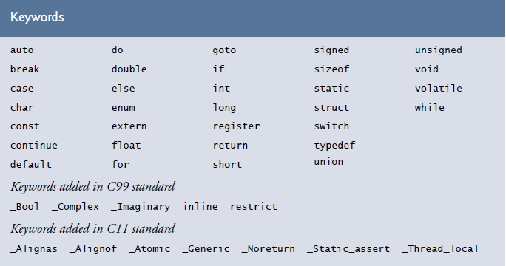
Data types and keywords
Keywords are predefined, reserved words used in programming that have special meanings to the compiler.
Part of the syntax and they cannot be used as an identifier.

Slide 18
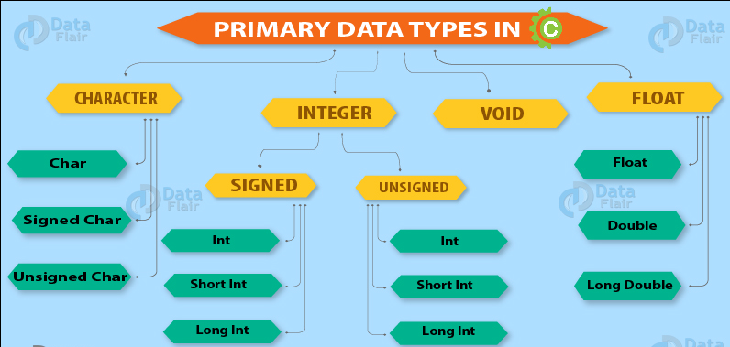
Data types and keywords
Data type is a keyword used for declaring variables or functions.
Each data type has its storage size

Slide 19
Data types and keywords
Data Types | Memory Size | Range
char | 1 byte | −128 to 127
signed char | 1 byte | −128 to 127
unsigned char | 1 byte | 0 to 255
short | 2 byte | −32,768 to 32,767
signed short | 2 byte | −32,768 to 32,767
unsigned short | 2 byte | 0 to 65,535
int | 2 byte | −32,768 to 32,767
signed int | 2 byte | −32,768 to 32,767
unsigned int | 2 byte | 0 to 65,535
Data Types | Memory Size | Range
short int | 2 byte | −32,768 to 32,767
signed short int | 2 byte | −32,768 to 32,767
unsigned short int | 2 byte | 0 to 65,535
long int | 4 byte | -2,147,483,648 to 2,147,483,647
signed long int | 4 byte | -2,147,483,648 to 2,147,483,647
unsigned long int | 4 byte | 0 to 4,294,967,295
float | 4 byte
double | 8 byte
long double | 10 byte

Slide 20
Data types and keywords
Example 1: Let’s test the data types in code
#include <stdio.h>
int main() {
short a;
int b;
long c;
double d;
printf("size of short = %d bytes\n", sizeof(a));
printf("size of int = %d bytes\n", sizeof(b));
printf("size of long = %d bytes\n", sizeof(c));
printf("size of float = %d bytes\n", sizeof(d));
return 0;
}

Slide 21

Exercise 02
Try other data types: $float, long double, char$
#include <stdio.h>
int main()
{
char a;
long double b;
float c;
printf("size of char = %d bytes\n", sizeof(a));
printf("size of long double = %d bytes\n", sizeof(b));
printf("size of float = %d bytes\n", sizeof(c));
return 0;
}

Slide 22
Introduction to C Programming
The structure of a basic C program
Data types and keywords
Mathematical Operations in C
I/O in C
Exercises: Pseudocode, Flow chart, Code
Conditions

Slide 23
Mathematical Operations in C
The basic mathematical operations in C are:
Operator | Description | Example
+ | Adds two operands. | A + B = 30
− | Subtracts second operand from the first. | A − B = -10
* | Multiplies both operands. | A * B = 200
/ | Divides numerator by de-numerator. | B / A = 2
% | Modulus Operator and remainder of after an integer division. | B % A = 0
++ | Increment operator increases the integer value by one. | A++
-- | Decrement operator decreases the integer value by one. | A--

Slide 24
Mathematical Operations in C
Example 2: Summation, subtraction, multiplication, dividing, modulus of two numbers
int a = 21, b = 10; int c;
c = a + b;
printf("a + b is %d\n", c);
printf("a - b is %d\n", a-b);
c = a * b;
printf("a * b is %d\n", c);
c = a / b;
printf("a / b is %d\n", c);
printf("a %% b is %d\n", a % b);
a = a++;
b = b--;
printf("The new value of a: %d\n", a);
printf("The new value of b: %d\n", b);

Slide 25

Mathematical Operations in C
Example 3: Calculate $(x+y) – (x−y)$
float x = 22.12; float y = 14.61;
float result = (x + y) - (x - y);
printf("The result is: %f\n", result);
return 0;

Slide 26

Exercise 03*
Calculate $(x + y) / (x − y)$ and $(x + y)(x − y)$
Try set $x ≠y$
Try set $x = y$
float x = 22.12; float y = 14.61;
float result1 = (x + y) / (x - y);
float result2 = (x + y) * (x - y);
printf("(x + y) / (x - y) is: %f\n", result1);
printf("(x + y) * (x - y) is: %f\n", result2);

Slide 27
Mathematical Operations in C
Bitwise operations are operations performed on a bit level:
Operator | Description | Example
& | Bitwise AND operation | A & B
| | Bitwise OR operation | A | B
~ | Bitwise NOT operation | ~A
^ | Bitwise XOR operation | A ^ B
<< | Left shift operator, the same as multiplying by B^2 | A << B
>> | Right shift operator, the same as dividing by B^2 | A >> B

Slide 28
Mathematical Operations in C
Example 4: Write a program that shifts a number to the right and another number to the left, then output the results.
int x = 5;
int y = x >> 1;
int a = 8;
int b = a << 1;
printf("Right shift of x is: %d\n", y);
printf("Left shift of a is: %d\n", b);

Slide 29
Exercise 04
Write a program that do AND, OR, NOT, XOR operations
Set x=1 and y = 0
Set x = 15 and y = 3
Set x = 0 and y = 8
int x = 1; // Try 15, 0
int y = 0; // Try 3, 8
printf("1 AND 0 = %d\n", x&y);
printf("1 OR 0 = %d\n", x|y);
printf("NOT 1 = %d\n", ~x); // Strange result !
printf("1 XOR 0 = %d\n", x^y);

Slide 30
Introduction to C Programming
The structure of a basic C program
Data types and keywords
Mathematical Operations in C
I/O in C
Exercises: Pseudocode, Flow chart, Code
Conditions

Slide 31

I/O in C
Example 5: To get input from user use $scanf()$ function
int x = 0; //initialize x to 0
// print the value of x
printf("x initial value = %d\n", x);
// prompte the user to enter a value
printf("Enter a value for x:");
// store user's input at the address of the variable x
scanf("%d: ", &x);
// print the new value of x
printf("Now x is: %d\n ", x);

Slide 32
Exercise 05
Write a program to get two numbers from a user and swap them then print the results.
int x = 0; //initialize x to 0
int y = 0; //initialize y to 0
printf("Enter a value for x: "); // tell the user to enter a value for x
scanf("%d", &x); // get value of x from user
printf("Enter a value for y: "); // tell the user to enter a value for y
scanf("%d", &y); // get value of y from user
/*Begin swapping*/
int z = x;
x = y;
y = z;
// print the results
printf("Now x is: %d, and y is: %d \n", x,y);

Slide 33

Exercise 06*
Given two variables $x$ and $y$, each stores its own value. Swap the values of the two variables. (DON’T use a third variables)
int x = 0; //initialize x to 0
int y = 0; //initialize y to 0
printf("Enter a value for x: "); // tell the user to enter a value for x
scanf("%d", &x); // get value of x from user
printf("Enter a value for y: "); // tell the user to enter a value for y
scanf("%d", &y); // get value of y from user
/*Begin swapping. You can use multiplication and division*/
x = x + y;
y = x - y;
x = x - y;
// print the results
printf("Now x is: %d, and y is: %d \n", x,y);

Slide 34
Introduction to C Programming
The structure of a basic C program
Data types and keywords
Mathematical Operations in C
I/O in C
Exercises: Pseudocode, Flow chart, Code
Conditions

Slide 35
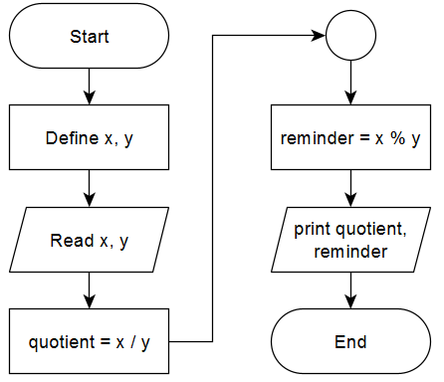
Exercise 07*
Write a C program to compute quotient and remainder of two numbers.
DEFINE: x, y
READ: x, y
COMPUTE: quotient = x / y
COMPUTE: reminder = x % y
OUTPUT: quotient, reminder

Slide 36
Exercise 07 cont.
Write a C program to compute quotient and remainder of two numbers.
int x = 0; int y = 0;
// read x, y
printf("Enter a value for x: ");
scanf("%d", &x);
printf("Enter a value for y: ");
scanf("%d", &y);
//calculate quotint
int quot = x / y;
//calculate reminder
int remi = x % y;
//output quotient, reminder
printf("The quotient = %d\n", quot);
printf("The reminder = %d\n", remi);

Slide 37
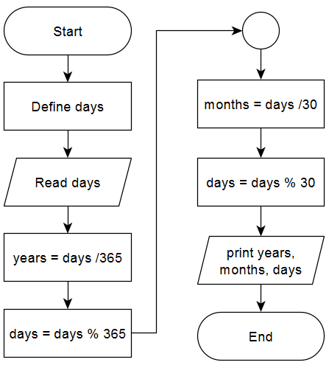

Exercise - 08
We have animal lived for $n$ days. Can you tell us how many years, months and days this animal lived?
A year is 365, and a month is 30 days
DEFINE: days
READ: days
COMPUTE: years = days / 365
COMPUTE: days = days % 365
COMPUTE: months = days / 30
COMPUTE: days = days % 30
OUTPUT: years, months, days

Slide 38

Exercise 08 cont.
We have animal lived for $n$ days. Can you tell us how many years, months and days this animal lived?
int days = 0;
printf("Enter number of days: ");
scanf("%d", &days);
int years = days / 365;
days = days % 365;
int months = days / 30;
days = days % 30;
printf("This animal lived for: %d years, \
%d months, %d days\n", years, months, days);

Slide 39

Exercise 09
An elephant decided to visit his friend. It turned out that the elephant's house is located at point $0$ and his friend's house is located at point x, where x > 0, of the coordinate line. In one step the elephant can move $1, 2, 3, 4 or 5$positions forward. Determine, what is the minimum number of steps he needs to make in order to get to his friend's house.

Slide 40
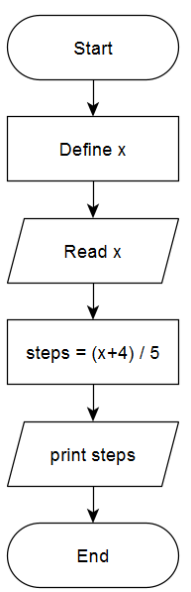
Exercise 09.
DEFINE: x
READ: x
COMPUTE: steps = (x+4)/5
OUTPUT: steps
int x = 0;
printf("Enter the location of the friend: ");
scanf("%d", &x);
int steps = (x + 4) / 5;
printf("The minimum number of steps = %d\n", steps);

Slide 41
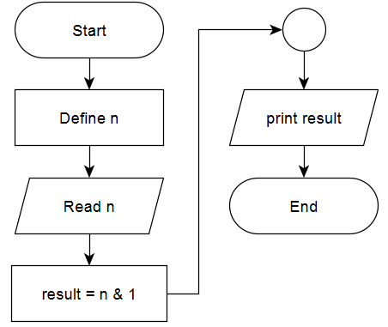

Exercise 10*
Write a program that reads an input $x$. If $x$ is even output 0 otherwise output 1.
Use bitwise operations (hint: an odd number has 1 as the first bit, while an even number has 0 as the first bit)
DEFINE: n
READ: n
COMPUTE: result = n & 1
OUTPUT: result
int n;
printf("Enter a number: ");
scanf("%d", &n);
printf("%d\n", n & 1);

Slide 42

TASKS
What kind of statements DON’T require a ; (hardcopy)
What is the difference between $int$ and $short int$? (hardcopy)
What are the constraints on declaring variables in C? (hardcopy)
Why ~ operator outputs an unexpected results? (Hardcopy) Why ~1 is -2 not 0 ?
Write a program that calculates the sum of 3 numbers (Softcopy)
Write a program that calculates the are of a circle (softcopy)
Write a C program to evaluate the arithmetic expression: (Softcopy) ((𝑎 + 𝑏 / 𝑐 ∗ 𝑑 − 𝑒) ∗ (𝑓 − 𝑔)) Get input from user

Slide 43

TASKS
8. To make people happy, sell candies!. The store bought a package of $n$ candies, for $x$ dollars each, and the store wants to know the total profit the store is going to earn after selling all $n$ candies for $y$ dollars each. Can you help the store to know? (softcopy)

Slide 44
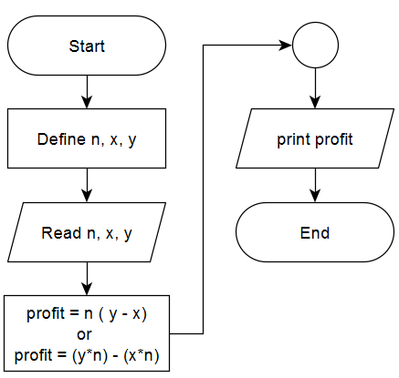
Answer to 08.
DEFINE: n, x, y
READ: n, x, y
COMPUTE: profit = n * ( y – x )
OUTPUT: profit

Slide 45
Answer to 08.
int n, x, y;
printf("Enter n: ");
scanf("%d", &n);
printf("Enter x: ");
scanf("%d", &x);
printf("Enter y: ");
scanf("%d", &y);
int profit = n * (y - x);
printf("The total profit is = %d\n", profit);
return 0;

Slide 46
Introduction to C Programming
The structure of a basic C program
Data types and keywords
Mathematical Operations in C
I/O in C
Exercises: Pseudocode, Flow chart, Code
Conditions

Slide 47
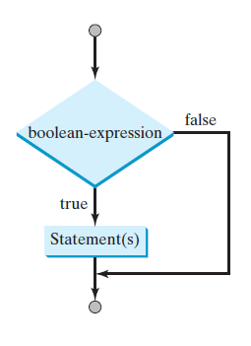
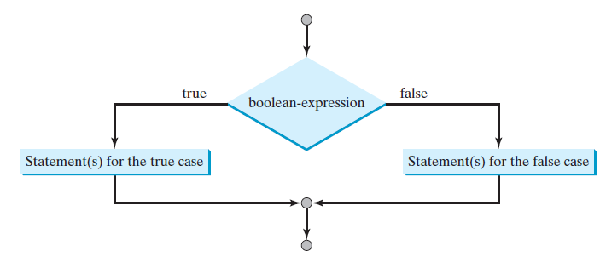

Conditions
To select statements to execute based on a condition, use $if$ and $if …else$statements.

Slide 48
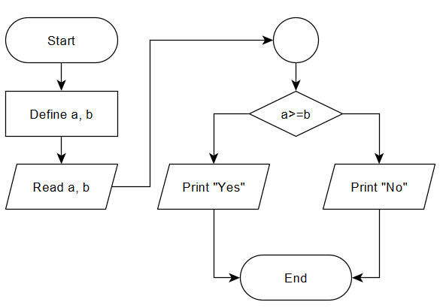
Exercise 11
Given two numbers A and B. Print "Yes" if A is greater than or equal to B. Otherwise print "No".
DEFINE: a, b
READ: a, b
IF: a>=b
Print “Yes”
ELSE
Print “No”

Slide 49
Exercise 11 cont.
Given two numbers A and B. Print "Yes" if A is greater than or equal to B. Otherwise print "No".
int a = 0;
int b = 0;
printf("Enter first value: ");
scanf("%d", &a);
printf("Enter second value: ");
scanf("%d", &b);
if(a>=b){
puts("Yes");
}
else{
puts("No");
}

Slide 50
Exercise 12
A character is entered through keyboard. Write a C program to determine whether the character entered is a capital letter, a small case letter, a digit or a special symbol using if-else and switch case.
A – Z →65 – 90
a – z →97 – 122
0 – 9 →48 – 57
Special symbols → 0 – 47, 58 – 64, 91 – 96, 123 – 127

Slide 51
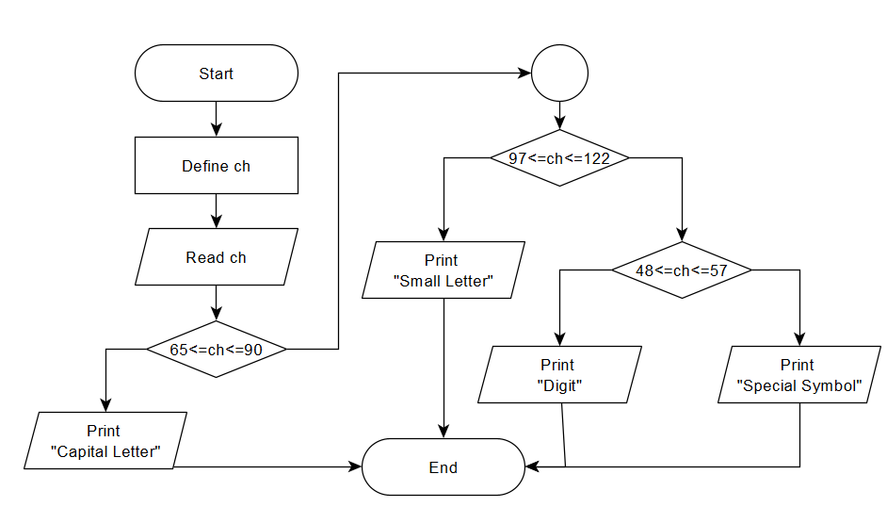
Exercise 12 cont.
DEFINE: ch
READ: ch
IF: 65<=ch<=90
OUTPUT: “Capital Letter”
ELSE IF: 97<=ch<=122
OUTPUT: “Small letter”
ELSE IF: 48<=ch<=57
OUTPUT: “Digit”
ELSE IF: (0<=ch<=47) OR (58<=ch<=64) OR (91<=ch<=96) OR (123<=ch<=127)
OUTPUT: “Special Symbol”

Slide 52
Exercise 12 cont.
char ch;
printf("enter a character: ");
scanf("%c", &ch);
if (ch >= 65 && ch <= 90)
printf("character is a capital letter\n");
else if (ch >= 97 && ch <= 122)
printf("character is a small letter\n");
else if (ch >= 48 && ch <= 57)
printf("character is a digit\n");
else if ((ch>0 && ch <= 47) || (ch >= 58 && ch <= 64) ||
(ch >= 91 && ch <= 96) || (ch >= 123 && ch <= 127))
printf("character is a special symbol\n");

Slide 53
Exercise 13*
Given the academic grade of one student determine his evaluation A, B, C, D, or F, Following that:
A when grade >= 90
B when grade >= 75
C when grade >= 60
D when grade >= 50
F when grade <50

Slide 54
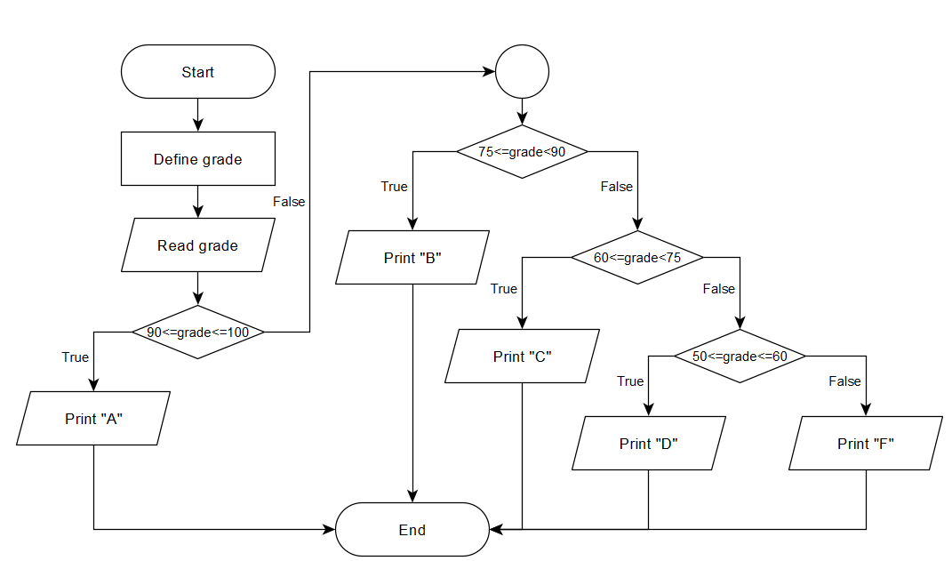
Exercise 13* cont.
DEFINE: grade
READ: grade
IF: 90<=grade<=100
OUTPUT: “A”
ELSE IF: 75<=grade<90
OUTPUT: “B”
ELSE IF: 60<=grade<75
OUTPUT: “C”
ELSE IF: 50<=grade<60
OUTPUT: “D”
ELSE:
OUTPUT: “F”

Slide 55
Exercise 13* cont.
int grade;
printf("Enter student's grade: ");
scanf("%d", grade);
if (grade >= 90 && grade <= 100)
puts("A");
else if (grade >= 75 && grade < 90)
puts("B");
else if (grade >= 60 && grade < 75)
puts("C");
else if (grade >= 50 && grade < 60)
printf("D\n");
else
printf("F");

Slide 56
Exercise 14
If cost price and selling price of an item is input through the keyboard, write a program to determine whether the seller has made profit or incurred loss. Write a C program to determine how much profit or loss incurred.
DEFINE: cost_price, sell_price
READ: cost_price, sell_price
IF: sell_price > cost_price
COMPUTE: profit = sell_price – cost_price
OUTPUT: profit
ELSE IF: cost_price > sell_price
COMPUTE: loss = cost_price – sell_price
OUTPUT: loss

Slide 57
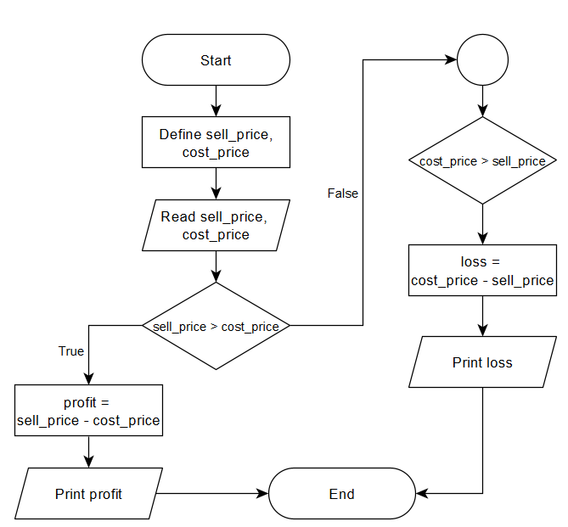
Exercise 14 cont.
float cost_price, selling_price;
printf("Enter the cost price of an item: ");
scanf("%f", &cost_price);
printf("Enter the selling price of an item: ");
scanf("%f", &selling_price);
if (selling_price > cost_price) {
float profit = selling_price - cost_price;
printf("We earn %.2f profit by selling item.\n", profit);
}
else if (selling_price < cost_price) {
float loss = cost_price - selling_price;
printf("We incurred %.2f loss on selling item.\n", loss);
}
else {
printf("We don't get any loss and profit on selling item\n");
}

Slide 58

TASKS
Write a C program to get input an integer of three digits, and find the sum of the individual digits. (Softcopy)
Example: 523 -> the sum of digits is 5+2+3=10
An elephant decided to visit his friend. It turned out that the elephant's house is located at point $0$ and his friend's house is located at point x, where x > 0, of the coordinate line. In one step the elephant can move $1, 2, 3, 4 or 5$positions forward. Determine, what is the minimum number of steps he needs to make in order to get to his friend's house. (Solve using if statements) (softcopy)

Slide 59

TASKS
3. Write program that reads an input $x$. If $x$ is even output “EVEN” otherwise output “ODD”. (Softcopy)
4. Problem statement: Given two numbers X, Y which donate coordinates of a point in 2D plan. Determine in which quarter it belongs. (Softcopy)
Output Q1, Q2, Q3, Q4 according to the quarter in which the point belongs to.
Output "Origen" If the point is at the origin.
Output "X-axis" If the point is over X axis.
Output "Y-axis" if the point is over Y axis

Slide 60

Summary
C programs must have $main()$ function as an entry point
Each variable must have a proper data type
C language has a set keywords that can’t be used as variables’ names
C language can do arithmetic bitwise operations
The $printf()$ requires a control parameter and a value to print
The $scanf()$ requires a control parameter and an address to the store the input
Selection statements uses $if, if…else, or if …else if$
ALWAYS THINK CREATIVELY, THINK LIKE A PROGRAMMER

